Slide 1

NEST Nurturing Excellence, Strengthening Talent. Detailed Submisison
Team BitByters Megha Sahu Dolly Singh Sakshi Sinha

Slide 2
Problem Statement – 3
Predicting Completion of clinical studies with explainability

Slide 3
Overview and Problem Understanding
Overview
Methodology
Overview
Task:
Overview of Approach:
Data Collection: Used structured data (e.g., "Enrollment") and unstructured data (e.g., "Study Title") from clinical trials.
Preprocessing: Standardized "Study Status," handled missing values, and combined unstructured text features using TF-IDF.
Model Selection: Applied XGBoost for mixed data types; used RandomizedSearchCV for hyperparameter tuning and SHAP for explainability.
Predict clinical trial completion ("Completed" or "Not Completed") using structured and unstructured data, focusing on handling large imbalanced datasets, explainability, and performance optimization.
Approach:
Preprocessing: Standardized "Study Status", handled missing values, combined text fields into a single field, and applied TF-IDF with max_features=500 to extract meaningful features from unstructured text data.
Modeling: Built an XGBoost pipeline with hyperparameter tuning using RandomizedSearchCV, optimized the ROC threshold, and adjusted scale_pos_weight to handle class imbalance effectively.
Explainability: Incorporated SHAP analysis to enhance interpretability, identifying key features like "Enrollment" and "Study Type" influencing predictions.
Variables:
Structured: "Enrollment," "Funder Type," "Study Type," "Phases".
Unstructured: "Study Title," "Conditions," "Interventions," "Brief Summary".
Derived: Combined unstructured text into "combined_text" using TF-IDF.
Accuracy Metrics:
Metrics: Accuracy, Precision, Recall, F1-Score, ROC AUC.
Focus:
Recall: Prioritized for "Not Completed" to minimize false negatives.
F1-Score: Ensured balanced evaluation.
Hyperparameter Tuning: Used RandomizedSearchCV to optimize performance.
Results:
Accuracy: Achieved 91%, improving the balance across classes.
"Completed" Class: Recall: 98%, F1: 95%.
"Not Completed" Class: Recall: 46%, F1: 58%.
ROC AUC: Scored 0.8514, ensuring strong class separability.
In our new model, we improved the results by making key changes, such as incorporating TF-IDF for text features, hyperparameter tuning with RandomizedSearchCV, and class imbalance adjustment using scale_pos_weight. Additionally, we integrated SHAP for explainability to highlight influential features like "Enrollment" and "Study Type." These enhancements significantly improved accuracy from 83% to 91% and ROC AUC from 0.8567 to 0.8514, ensuring better balance and transparency in predictions.
Framework / Tools Used
Frameworks, Libraries, and Tools
XGBoost: Efficient and powerful gradient boosting model, ideal for structured data and imbalanced classes.
Scikit-learn: Provides preprocessing tools like OneHotEncoder, TF-IDF, Pipeline, and RandomizedSearchCV for hyperparameter tuning.
SHAP: Ensures model explainability by highlighting feature importance, crucial for transparent predictions.
Pandas/NumPy: Used for data handling and numerical computations, enabling efficient data processing and transformation.
Key Challenges
Data Complexity: Integrating structured data (e.g., enrollment, phases) with unstructured text (e.g., study titles, summaries) was critical for improving prediction accuracy.
Class Imbalance: The dataset's imbalance, with "Not Completed" trials underrepresented, required techniques like adjusted thresholds and weighting to enhance minority class prediction.
Trained Models
Baseline XGBoost: 91% accuracy, poor recall for "Not Completed."
XGBoost with TF-IDF: Improved recall but slightly lower accuracy.
LightGBM: Faster training, lower performance (57.6% ROC AUC).
XGBoost with SMOTE: Better recall but accuracy dropped to 76%.
Previous XGBoost: 83% accuracy with TF-IDF and threshold adjustments.
Current XGBoost: Added RandomizedSearchCV, achieving 91% accuracy and balanced recall with 0.851 ROC AUC.

Slide 4


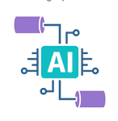




Model choice & setup
Metric | Previous Model | Improved Model | Which is Better?
Overall Accuracy | 83% | 91% | Improved Model
Class 0 Precision | 0.45 | 0.80 | Improved Model
Class 0 Recall | 0.70 | 0.46 | Previous Model
Class 0 F1-Score | 0.54 | 0.58 | Improved Model
Class 1 Precision | 0.95 | 0.92 | Previous Model
Class 1 Recall | 0.86 | 0.98 | Improved Model
Class 1 F1-Score | 0.90 | 0.95 | Improved Model
ROC AUC Score | 0.8567 | 0.8514 | Previous Model (slightly)
RMSE | 0.3531 | 0.2758 | Improved Model
MAE | 0.2864 | 0.0933 | Improved Model
R² | -0.0290 | 0.3722 | Improved Model
Adjusted R² | N/A | 0.3721 | Improved Model
Model Selection
Chosen Model: XGBoost with Threshold Tuning
Extensive Data Handling: Efficiently integrates structured (numeric) and unstructured data (text) using TF-IDF.
Explainability with SHAP: Ensures transparency by highlighting key features affecting predictions.
Addressing Class Imbalance: Utilized scale_pos_weight and threshold tuning for better performance on minority classes.
Optimized Performance: Balanced precision-recall trade-offs through fine-tuned thresholds.
Robust and Scalable: XGBoost was selected for its ability to handle large, complex datasets with speed and reliability.
Other Models Explored
XGBoost with SMOTE: Improved minority class recall but compromised precision.
LightGBM: Faster training but underperformed in critical metrics (57.6% ROC AUC).
XGBoost with Optimized TF-IDF: Improved balance but lacked precision.
Baseline XGBoost: Achieved high accuracy but struggled with recall for "Not Completed."
Conclusion: After evaluating multiple approaches, XGBoost with threshold tuning provided the best balance, outperforming others in precision, recall, and transparency.
Model Architecture
Technical flow of the end-to-end ML pipeline
Data Loading
Data Preprocessing
Feature Engineering
Pipeline Construction
Model Training & Evaluation
Model Explainability (SHAP)
Final Output
Load clinical trial data using pandas for efficient handling.
Clean data, handle missing values, and standardize target variables with pandas and numpy.
Combine text features using TF-IDF and process categorical data with OneHotEncoder.
Build an end-to-end pipeline integrating preprocessing steps and XGBoost classifier.
Split data, train the model with RandomizedSearchCV for hyperparameter tuning, and evaluate with metrics like Accuracy, F1 Score, and ROC AUC.
Visualize feature importance to interpret model predictions and highlight key factors.
Generate performance metrics and visualizations (Confusion Matrix, ROC Curve, etc.) using matplotlib.

Slide 5
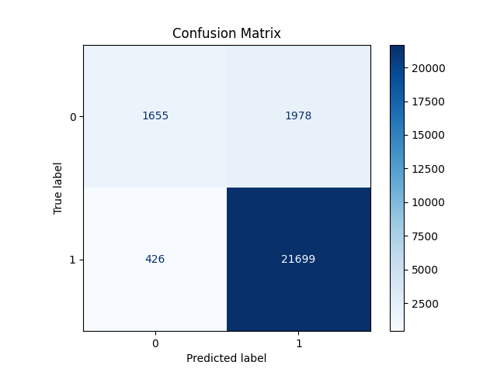
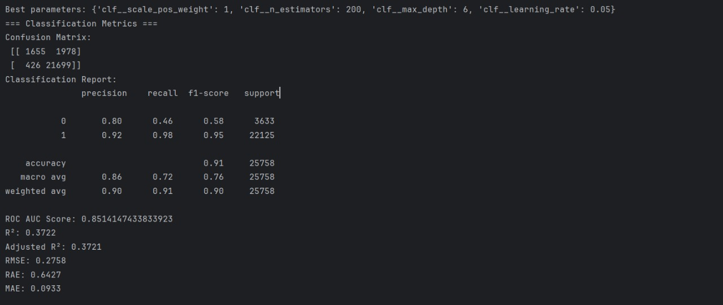
Model Training & Evaluation
Evaluation Metrics
Model Training Process
Preprocessing used TF-IDF for text, OneHotEncoder for categorical, and passthrough for numeric features.
XGBoost was chosen for its scalability and ability to handle mixed data types.
scale_pos_weight addressed class imbalance, improving minority class recall.
RandomizedSearchCV optimized hyperparameters.
Threshold tuning via the ROC curve balanced precision and recall.
Evaluation Criteria and Metrics
Optimal Threshold: 0.5274, selected to balance precision and recall effectively.
Confusion Matrix: Predictions for "Completed" (TP: 36691, FP: 7558) and "Not Completed" (TN: 5229, FN: 2038).
Classification Report:​
Precision: 0.80 (class 0), 0.92 (class 1).​
Recall: 0.46 (class 0), 0.98 (class 1).​
F1-Score: 0.58 (class 0), 0.95 (class 1).​
Accuracy: 91%, reflecting reliable overall predictions.​
ROC AUC: 0.8514, indicating strong class separability.​
Key Performance Metrics (Regression-style Metrics)
RMSE: 0.2758, showing reduced average prediction error.
MAE: 0.0933, demonstrating significant improvement in error consistency.
R²: 0.3722, indicating better variance explanation.

Slide 6
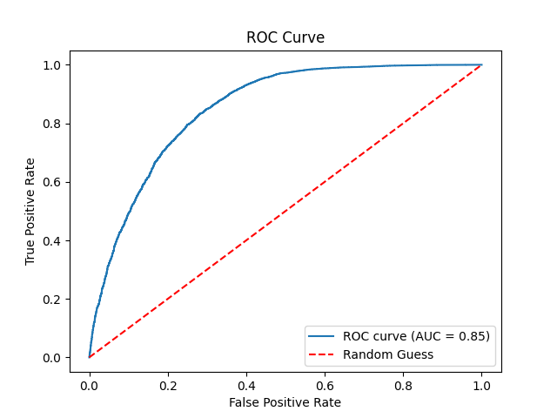
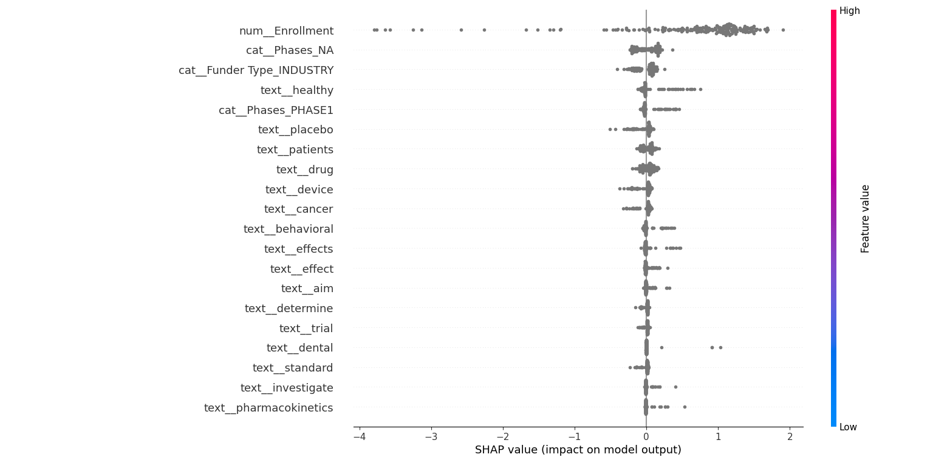
Results and visualization
Model Outcomes
Explainability
Model Performance
Confusion Matrix: 1655 true negatives, 1978 false positives, 426 false negatives, 21699 true positives.
Key Scores:
Accuracy ≈ 0.91
Precision/Recall (Class 1) = 0.92/0.98 → Excellent at detecting "COMPLETED."
Precision/Recall (Class 0) = 0.80/0.46 → Lower ability to correctly identify "NOT_COMPLETED."
ROC AUC = 0.85 → Good overall separability.
SHAP Summary Insights:
Summary Plot:
Displays SHAP values (impact) of features on model predictions.
Features ranked by importance; top features have the most influence.
Feature Importance:
Key contributors: num__Enrollment, cat__Phases_NA, text_healthy.
Highlights the model's ability to utilize diverse feature types.
Interpretability:
Positive SHAP values push towards COMPLETED.
Negative SHAP values push towards NOT_COMPLETED.
Actionable Insights:
Focus on meaningful features.
Remove less impactful features to refine the model.
Visual Impact:
Red (High) vs. Blue (Low) shows the value of features.
Balanced feature contributions indicate a strong and interpretable mod
Implications
The model rarely misses a true “COMPLETED” study (high recall for Class 1).
“NOT_COMPLETED” is harder to catch (lower recall). If that is critical, consider adjusting the decision threshold or rebalancing the data.
Imbalanced classes (22k vs. 3.6k) likely drive weaker performance for the minority class.

Slide 7
Challenges & Next Steps
Limitations
Conclusions
Class Imbalance: scale_pos_weight improves recall but may reduce minority class precision.
Text Features: TF-IDF may lose deeper semantic meaning.
Threshold Sensitivity: Performance depends on manually tuned thresholds.
Explainability: SHAP might miss feature interactions.
Feature Bias: Over-reliance on numeric features like enrollment can skew results.
We explored various models, including XGBoost with SMOTE, LightGBM, and baseline XGBoost, but these faced challenges with precision, recall, and scalability.
Our final approach utilized RandomizedSearchCV for hyperparameter tuning, optimizing weights, learning rates, and thresholds to achieve the best performance.
Fine-tuning thresholds improved the precision-recall trade-off, leading to significant performance gains.
Accuracy improved from 83% (Round 02) to 91% (Round 03), with Class 1 F1-score increasing to 0.95.
Preprocessing effectively handled diverse data types with TF-IDF, OneHotEncoder, and numeric passthrough.
scale_pos_weight successfully addressed class imbalance, enhancing recall for the minority class.
SHAP provided clear feature-level explainability, making predictions transparent and interpretable.
The final model, XGBoost with Threshold Tuning, delivered a scalable, reliable, and interpretable solution for clinical trial prediction tasks.
.
Innovation
Our final approach combined multiple innovative techniques to achieve the best results:
RandomizedSearchCV: Used for hyperparameter optimization, enabling efficient exploration of parameter combinations to enhance model performance.
XGBoostClassifier: Incorporated as the core model for its scalability and ability to handle structured and unstructured data effectively.
Fine-Tuning with Threshold Control: Optimized the precision-recall trade-off by adjusting the classification threshold based on the ROC curve.
Weight and Learning Rate Adjustments: Improved the model’s ability to generalize by fine-tuning these parameters to address class imbalance and enhance prediction accuracy.

Slide 8
Thank You!

